Slide 1

Helping Eye
Sahil Sharma & bidya dash

Slide 2
What is HELPING EYE?
Helping Eye is a proposed method in detecting survivors after a natural calamity and also help people locate their relatives or pets.

Slide 3
Why This?
We come from Odisha, a coastal state in India affected by cyclones every year. We also hail from a country (India) where we experience continuous array of disasters distributed across the topography (Flood in some parts, earthquakes in others) and the effect of such calamities is devastating.
Considering cyclones, the Super Cyclone (1999) and Fani (2019) were the most notable ones where airspeed went upto 160 mph after landfall.
The cyclone’s eye passing through the place is quite terrifying but even more catastrophic is the aftermath.
People can’t find their relatives, their pets, cattle, their loved ones.
Disaster Relief Team searches frantically in every part of the city requiring a lot of time, resources and manpower but still there are places where a relief team can’t reach.
That’s where we want to help, covering those inaccessible areas using an eye which is similar to a human rescuer’s eye.

Slide 4
Proposed solution
We plan to boost-up this search and relief process by deploying Artificial Intelligence.
We plan to use a drone to capture live video footage of certain areas affected by the cyclone and relay them back to the center along with the GPS coordinates.
The center would be having a Neural Network architecture running on a powerful machine that would detect the frames wherever there are survivors and flag the GPS coordinate of the drone.
We have used a Faster R-CNN architecture that detects objects trained on the MSCOCO dataset. Hence, it can detect people and animals with great accuracy. The performance of the algorithm can be significantly improved by the underlying processing speed of the center which has been implemented in the algorithm.

Slide 5
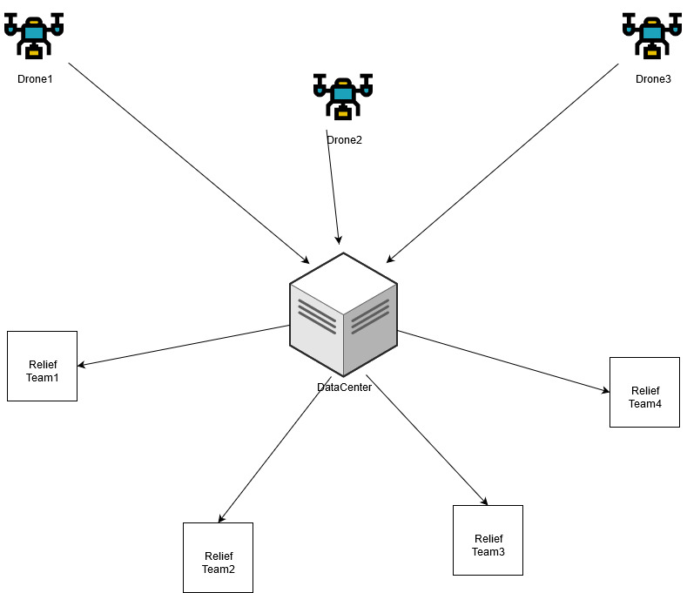
Flow diagram

Slide 6
Our implementation
A client (drone) is sending the video feed to the server side (Data-Center) in low resolution given the bandwidth constraints.
This video is then analyzed by our algorithm which uses a Faster R-CNN (high accuracy and fast detection) and then detecting survivors in after- math of a natural disaster.
After this, we have devised a way to flag off whenever survivors are detected in the video feed and then notifying the response team with the GPS coordinates of the flagged area.

Slide 7
Future prospects
This can be further extended as to run a pre-trained low resources (less accuracy, kind of like first pass) Neural net architecture on the drone itself and flagging the Relief teams faster, and then sending the feed to Center as second pass.
The Data-Center block can be used as a second pass to assure we have high accuracy in the entire system.
The algorithm can be fine tuned to run on low resources as a Raspberry Pi module attached to a drone. Drones can talk to each other and notify other drones about hot areas, such that those drones can automatically scan such areas which will increase the field of view.

